Slide 1
INVASIVE SPECIES PROBLEMS
World-wide problem
Increase in travel and trade open routes
In U.S. costs $137 billion dollars per year
Approximately 42% of Threatened or Endangered species are at risk due to non-native, invasive species.
Raise havoc in ecosystems and threaten species diversity

Slide 2
Terminology
Native – species found within its natural range
Non-native (introduced, alien, exotic, non-indigenous) – a species living outside it native distribution range which has arrived there by human activity either deliberate or accidental.
Note: non-native, introduced, exotic, non-indigenous and alien are often used interchangeably.
Feral (released pets, livestock and game animals) – an animal living in the wild but descended from domesticated individuals
Human commensal or subsidized (out of control natives) - native species that benefit from our land use (disturbance)
Invasive species - species that spread subsequent to establishment usually at some cost. US legal definition - an alien species whose introduction does or is likely to cause economic or environmental harm or harm to human health.

Slide 3
Overview of Situation

Slide 4
Causes of Invasion
Introduced as a result of human activity – estimated 50,000 exotic organisms released in US every year – globalization has increased individual and commercial long distance travel and trade resulting in the altering of important waterways. Non-native species are introduced as a result and some species become invasive species.
10% Rule – Only 10% of introduced exotics will live at all due to wrong climate, food availability and other factors; of the 10% that live, only 10% will actually breed and become invasive – EPA estimates. 6,500 established invasive species in the U.S. (USGS)

Slide 5
Vectors or Modes for Invasion

Slide 6
Intentional Release
Intentional Release- Release of Target Species into the Environment
Economic Purposes – nutria
Plants for Agriculture
Plants for Forestry
Plants for Soil Improvements - fire suppression, erosion control
Aesthetic reasons – honeysuckle, purple loosestrife
Ornamental Plants
Cultural Purposes – starlings, Asian Shore crabs
Birds and Mammals for Hunting
Misguided Environmental Projects – Kudzu, Multiflora rose
Biological Control – species intended as controls become invasive
Released Pets and Pet Trade
Naturalization societies
Shakespeare fans – plan to release all birds mentioned in works of Shakespeare – 12 birds released including European Starling
Domestic animals
Release of lab animals or plants – by science teachers and researchers

Slide 7
Accidental Release
Accidental Releases - Release of Non-Target Species
Ballast water in ships (Green crab, Zebra Mussel, Comb Jellyfish)
Canals – as St. Lawrence River & Great Lake system
Timber – unprocessed wood
Accident release of organisms – gypsy moth, “Killer” African bees
Contaminants of Seed Stock
Fruit Shipments
Transfer in packing material (European Green Crab to CA, Horned Asian Beetle)
By-pass natural barriers
Cars and Planes
Tourists, Luggage
As Hitchhikers with Packing Material, Cargo
As Contaminants or Hitchhikers with Produce
As Contaminants or Hitchhikers with Ornamental Plants
As Contaminants or Hitchhikers with Aquaculture

Slide 8
Effects of Invasive Species on Ecosystems
Direct competition with native species
Lose of species diversity – may cause native species to become endangered
Short-circuit interactions in natural communities & disrupt natural food web
Affect entire ecosystem functions as water availability and nutrient cycle

Slide 9
ECONOMIC EFFECTS
Billions of dollars in damage to forests, property values, agricultural productivity, public utility operations, native fisheries, tourism, outdoor recreation
Billions of dollars in programs by federal and state agencies to control invasive species
$137 billion in damages per year

Slide 10
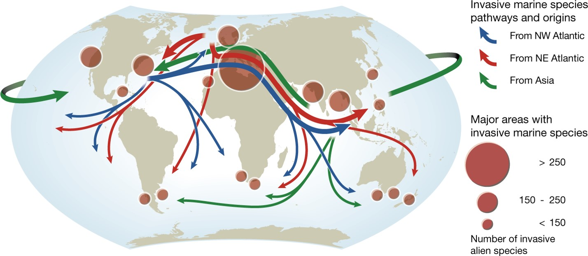
Tracking the Aquatic Invasive Species

Slide 11
Invasive Species by State

Slide 12
Invasion Process

Slide 13
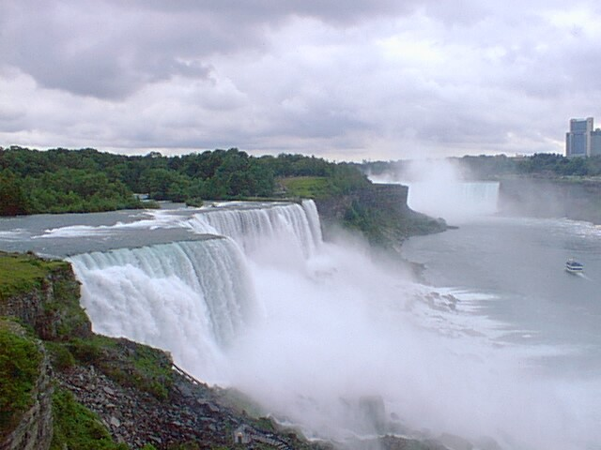
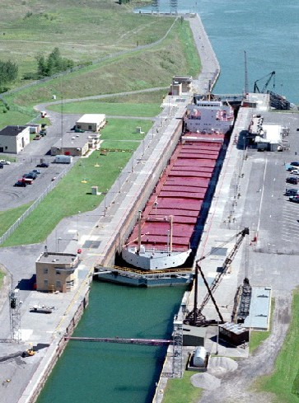
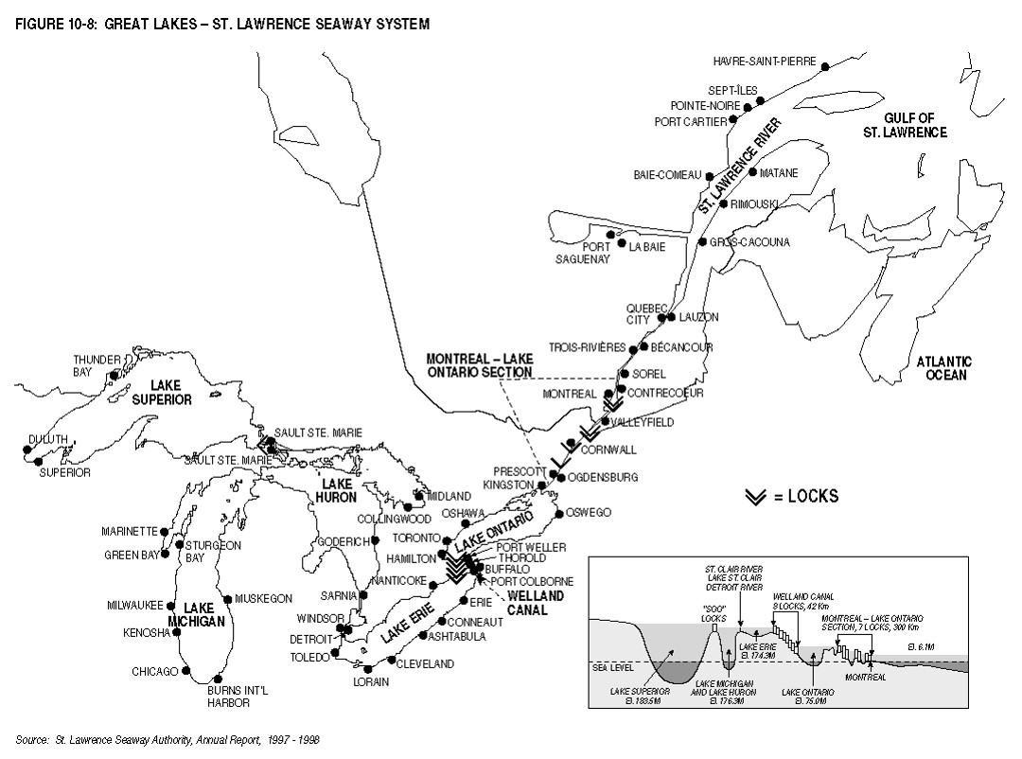
EXAMPLE OF INVASIVE PROCESS
The St. Lawrence Seaway is the common name for a system of canals that permits ocean-going vessels to travel from the Atlantic Ocean to the North American Great Lakes, as far as Lake Superior.
Niagara Falls was a major challenge – Weland Canal lock system set up to bypass falls
The Seaway opened in 1959 and cost $470 million US dollars.

Slide 14
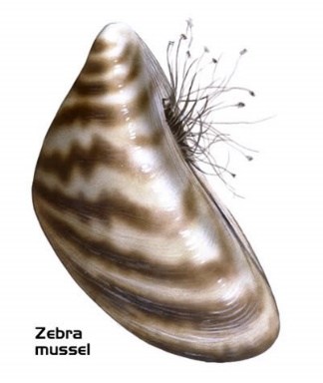
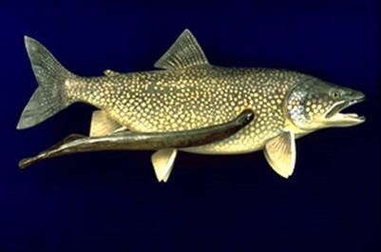
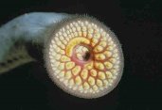
Result of St. Lawrence Seaway
The creation of the seaway also led to the introduction of foreign species of aquatic animals, including the sea lamprey, alewife, and the zebra mussel as well as plant species into the Great Lakes Basin.
These organisms were introduced via ballast water from oceanic vessels.

Slide 15
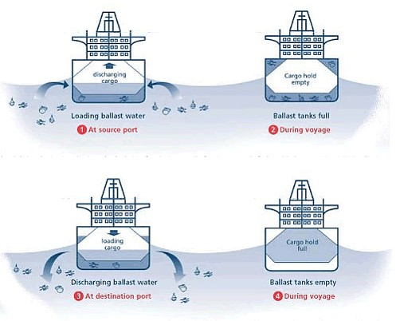
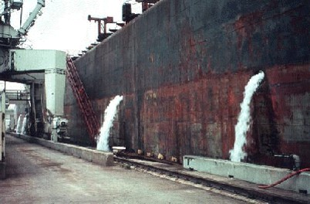
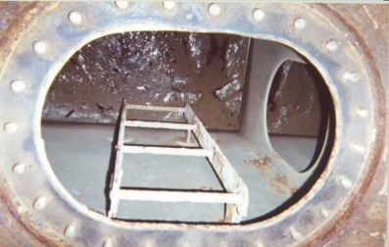
Ballast Water Problem

Slide 16
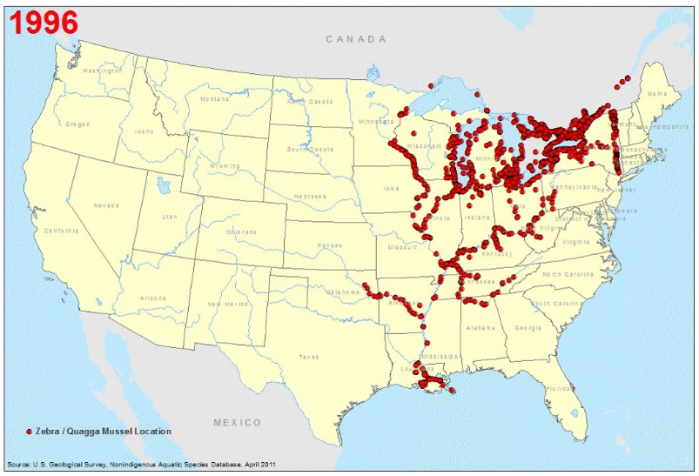
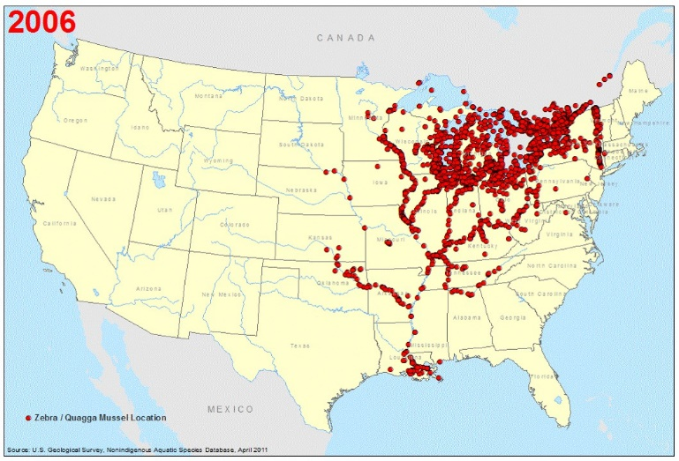
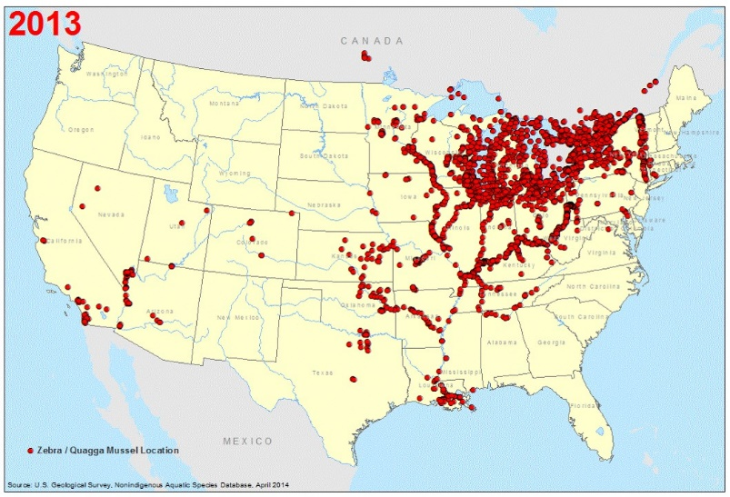
Zebra Mussel Spread

Slide 17
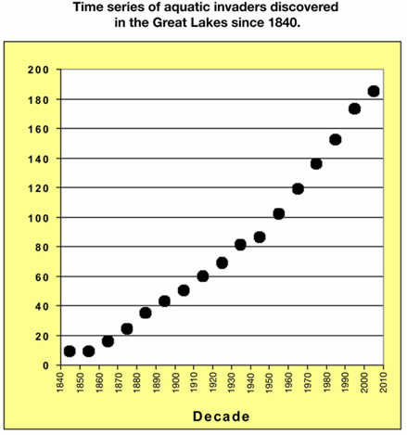
Invasive Species Increase in Great Lakes

Slide 18
Characteristics of Invasive Species

Slide 19
Invasion Curve

Slide 20
Timing for the Control of Invasive Species

Slide 21
Control Methods
Prevention
Eradicating potential invaders soon after invasion
Physical (manual & mechanical)
Cultural – Ecosystem Management
Biological – natural enemies
Chemical - pesticides
Integrated Pest Management – Uses a combination of methods – OFTEN MOST EFFECTIVE

Slide 22
Side Effects of Control Methods
Biological – control species can become invasive
Chemical – may kill native species
Physical – may miss removing some of the invasive species
Prevention – apathy and lack of awareness

