Slide 1
Inv. Species – Aquatics
Lesson 3

Slide 2
Alewife Alosa pseudoharengus
The front of the body is deeper and wider
than other fish in the area
Generally blue-ish
It is invasive to the Great Lakes
Weirdly, it’s population is in decline in New England waters
Was allowed to spread in the Great Lakes because it’s natural predators were thinned out from fishing

Slide 3
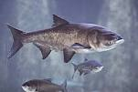
Asian Carps
Describes nine types of carp
Four of which are invasive
Look how angry this fish looks
They were distributed in the U.S. as a foodfish
There has been extensive movements to prevent the spread of Asian carp to the Great Lakes

Slide 4
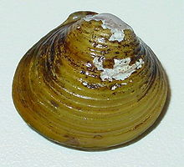
Asian Clam Corbicula fluminea
Yellow/green shell with concentric circles
Flakey outside which often leads to white spots
Inside is a light purple color
Not in the Great Lakes
The primary damage is due to these clams clogging up various pipes

Slide 5
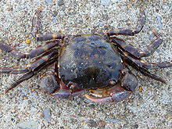
Asian Shore Crab Hemigrapsus sanguineus
3 “teeth” along the sides
Light bands around its legs
Not found in the Great Lakes
Since these crabs eat almost anything, they have a large impact on the food web
It competes with some native crabs as well

Slide 6
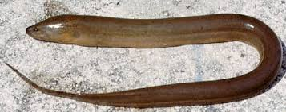
Asian Swamp Eel Monopterus albus
It’s an eel
It’s long snake-like
Found disrupting the ecosystems, primarily in the Everglades
They’re researching controls but they kind of suck as of now

Slide 7
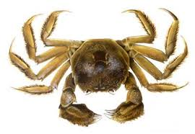
Chinese Mitten Crab Eriocheir sinensis
“Furry” claws
Has been introduced to the Great Lakes several times but has never been able to establish a population
Damages embankments and clogs drainage systems
Control is primarily due to strict laws regarding the transport and possession of these crabs

Slide 8
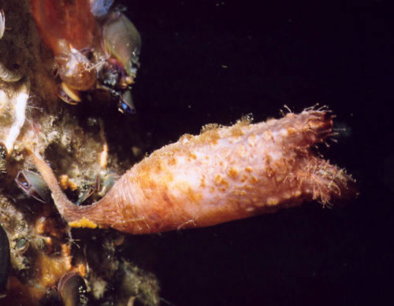
Clubbed Tunicate Styela clava
Brown or yellow
Rough, wrinkled surface
Control is manual removal
Attaches itself to manmade objects such as docks and aquatic gear

Slide 9
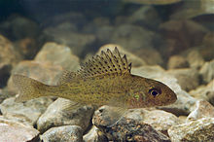
Eurasian Ruffe Gymnocephalus cernuus
Olive/Golden-brown back, paler on the sides
Yellow/white underside
Back fins have soft spines “rays”
Has a “frowny” mouth
Invaded the Great Lakes
Similar diet habits but massive reproduction
Releasing predators, poison and the release of phermones

Slide 10
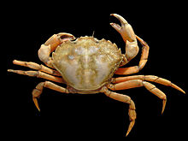
European Green Crab Carcinus maenas
Not always green (can be brown/red/grey)
5 “teeth” on each side of eyes
3 “teeth” between the eyes
Not in great lakes
Does crab things to disrupt ecosystem
Blue crab > Green crab
A bounty was placed as a control

Slide 11
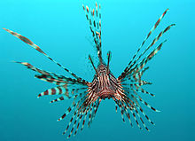
Lionfish Pterois volitans
C’mon
Not in the U.S.
Like most invasive fish, they eat anything and eat a lot

Slide 12
Northern Snakehead Channa argus
49-50 rays along the top, 31-32 along the bottom
Head shape
Close to the Great Lakes
Top-level predator
Introduced as a foodfish

Slide 13
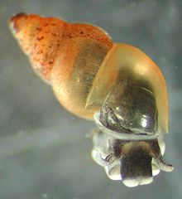
New Zealand Mud Snail Potamopyrgus antipodarum
It’s a snail!
Huge problem in the Great Lakes
In native habitats, populations are controlled by a
parasite that sterilizes snails

Slide 14
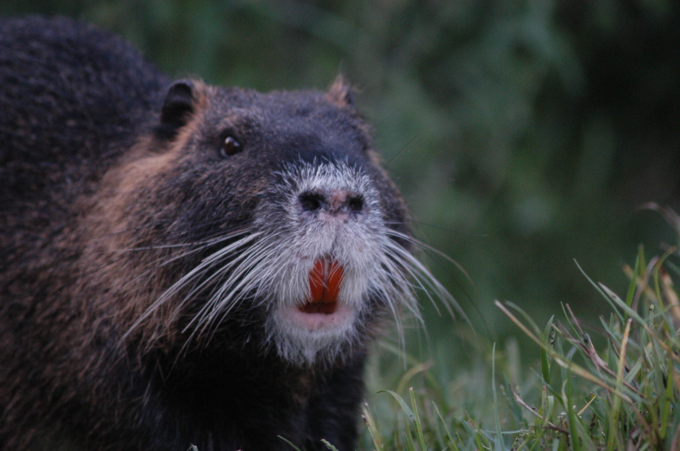
Nutria Myocastor coypus
Pls
Commonly called a “Coypu”
Imported for its fur. No one wants its fur anymore
Not in the Great Lakes
Basically, they eat everything in wetlands
Planting more wetland things (very stupid) and harvesting nutria o.o

Slide 15
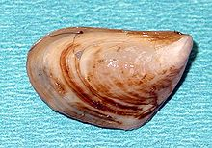
Quagga Mussel Dreissena bugensis
Striped/zig-zag shell
Pale colored on the edge of the shell
Much lighter than zebra mussels
Huge problem in the Great Lakes
They remove huge amounts of phytoplankton from the water
Disrupts the food chain

Slide 16
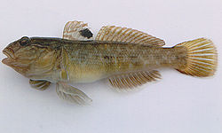
Round Goby Neogobius melanostomus
Black spot on fin
Large, protruding eyes
Found in the Great Lakes
Introduced through ballast water transfer
They have predators, but they still outcompete native fish
Random side effect, the formerly endangered Lake Erie Watersnake is no longer endangered because they eat Round Gobys.

Slide 17
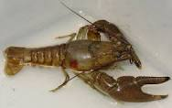
Rusty Crayfish Orconectes rusticus
Rusty color on sides of back
Black bands on tips of claws
Found in Michigan
Hard to control naturally because native crayfish do not fight back like this species does
There is a chemical that only kills crayfish, but it also kills native crayfish
Manuel human removal

Slide 18
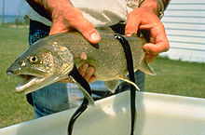
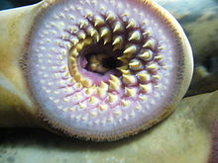
Sea Lamprey Petromyzon marinus
Brown/grey/black on top
White/grey on underside
Found in the Great Lakes
Introduced from New England by the Erie Canal
Combined with fishing, destroyed most of the trout population
Controls include electric current, chemicals and firearms

Slide 19
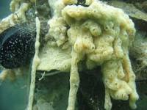
Sea Squirt Didemnum vexillum
Smooth, leathery, veined sacs
Orange/pink/tan/cream/grey
Not found in the Great Lakes
Basically smothers everything it grows over

Slide 20
Spiny Water Flea Bythotrephes longimanus
3-4 barbs
One large black/red eye
Found in the Great Lakes
Not actually a flea
They compete with native small fishes while being difficult to remove because they are unable to be eaten by smaller fish

Slide 21
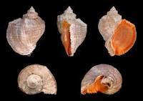
Veined Rapa Whelk Rapana venosa
I am honestly horrible at describing shells
Not found in the Great Lakes
Hard shell makes it difficult for native whelks to kill the Rapa but the Rapa can kill natives
Studies still going on regarding the damage this species does so I’m not sure why it’s already classified as invasive

Slide 22
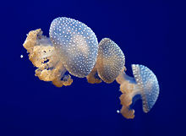
White Spotted Jellyfish Phyllorhiza punctata
The only jellyfish we’re looking at
It’s white and spotted
Not found in Great Lakes (duh)
Feeds on commercial fish/eggs/crab/shrimp/etc
Controls including trying to herd them elsewhere

Slide 23
Zebra Mussel Dreissenna polymorpha
They’re striped like zebras
Found in Great Lakes
Blocking pipelines
Causing extinction of native species
They cut people’s feet
Controls include crayfish and liquid fertilizer (still testing)

