Slide 1
Invasive Species – Invertebrats
Lesson 2

Slide 2
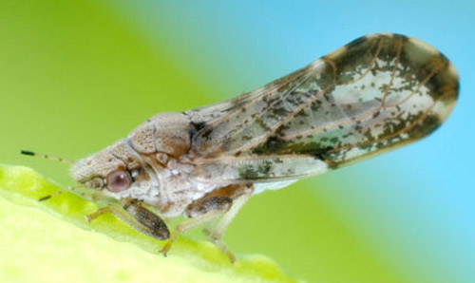
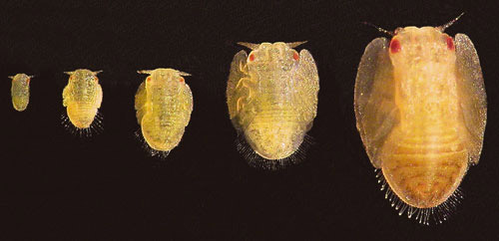
Asian Citrus Psyllid Diaphorina citri
3-4 mm
Light brown head
Brown band around the wing
Antennae have black tips with brown spots
Covered with a white, waxy secretion making it appear dusty

Slide 3
Asian Citrus Psyllid Diaphorina citri (cont.)
It kills citrus plants by spreading disease
Are generally moved around by infected plants
Not found in Michigan

Slide 4
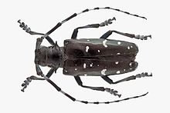
Asian Long-Horned Beetle Anoplophora glabripennis
Very long black and white antennae
Glossy black with irregular white spots
Box-shaped body structure
Spread within wood packing material from Asia (duh.)
Can be found in Michigan
Destroys hardwood trees
Quarantines, shipment of infested trees, insecticide and shipping restrictions have all been attempted

Slide 5
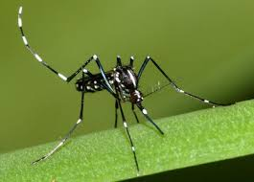
Asian Tiger Mosquito Aedes albopictus
Black and white striped legs
Small black and white striped body
Transmits many diseases such as Yellow Fever and Dengue Fever.
Recently invaded Michigan
Control is generally by destroying their eggs

Slide 6
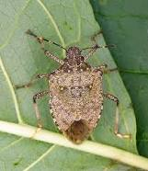
Brown Marmorated Stink Bug Halyomorpha halys
They are brown on both sides although they vary in shade
They have grey, white or bluish markings
Alternating light bands on the antennae
Alternating dark bands on the outer edge of the abdomen
Is present in Michigan
Destroys fruit crops
Invades homes and other buildings in the fall to survive the winter
Entered the U.S. through packing crates

Slide 7
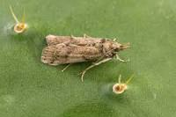
Cactus Moth Cactoblastis cactorum
The adult version looks exactly like other moths
Only way to tell is to surgically remove and examine
the genitalia of a male moth
The larvae are a pink-cream color with black bands that eventually becomes orange with black bands

Slide 8
Cactus Moth Cactoblastis cactorum (cont.)
Was first introduced to Australia + a few other places as a pest control agent (on purpose). It worked, in Australia, the Cactus Moth is not an inv. species
The Cactus Moth came to the U.S. through both intentional as well as unintentional means
They endanger various cactus species
Not found in Michigan
Main methods of control are bacterial and predator introduction. The bacteria and wasps don’t work too well. The ants that have been tested so far work

Slide 9
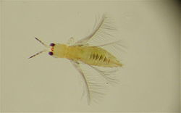
Chilli Thrips Scirtothrips dorsalis
< 1 mm in length
Yellow body with dark striping
Dark antennae
Plants attacked by this species develop wrinkly leaves with distinctive brown scarring
Destroys fruit crops
Not found in Michigan
Develops resistances to insecticides very quickly
Fungi have been used as a control

Slide 10
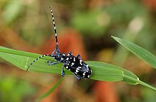
Citrus Longhorned Beetle Anoplophora chinensis
Very long black and white antennae
Glossy black with irregular white spots
Thinner body
Attacks hardwood trees
Has no natural enemies/predators
Has been eradicated from the U.S.

Slide 11
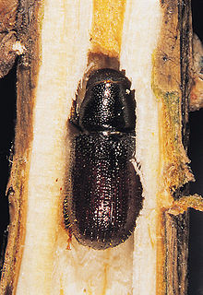
Common Pine Shoot Beetle Tomicus piniperda
Black or dark brown, capsule-like shape
Pretty ugly
Does not kill trees it eats, but drastically reduces
the value of the lumber
Is found in Michigan
Spread accidently through lumber shipments (probably)
Control is through regulation and quarantine

Slide 12
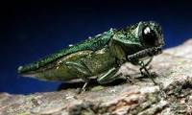
Emerald Ash Borer Agrilus planipennis
I mean they’re bright green.
Not a problem in native environment so we didn’t know how to deal with them when they became invasive and got out of control
Is found in Michigan
Destroys ash trees; following an infestation all ash trees in the area are expected to be destroyed within ten years
Controls are tree removal (very low scale solution), insecticides (only works in less dense regions) and biologic control (limited effect)

Slide 13
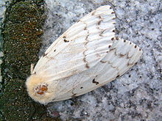
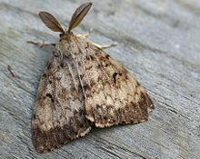
European Gypsy Moth Lymantria dispar
These things are scary as hell as larvae, look it up yourself
Female
Male

Slide 14
European Gypsy Moth Lymantria dispar (cont.)
The larvae consumes the leaves of over 500 plant species
Is found in Michigan
Originally brought over from Europe in order to be bred with silk worms to develop a silkworm industry
Were accidently released
Good going man

Slide 15
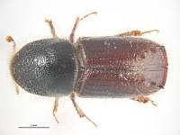
European Spruce Bark Beetle Ips typographus
Long, cylindrical with a rounded front
Black or dark brown
Has one of the most complicated roles in the ecosystem compared to other inv. species (not impact, but relationships with other species)
Attacks trees and spreads various fungi
Not in Michigan (or the U.S. at all)

Slide 16
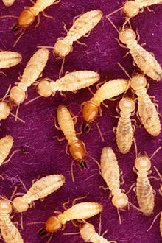
Formosan Subterranean Termite Coptotermes formosanus
Unique due to the huge size of their colonies; several million termites may live in a single colony
Infests all kinds of wooden things
Not found in Michigan
Control is mostly pesticides

Slide 17
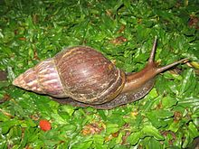
Giant African Snail Lissachatina fulica
Conical banded shell
Various colors based on diet
but predominantly brown
More specifically, is called the Giant East African Snail
Eats a lot and spreads mostly plant pathogens (some human pathogens)
Not found in Michigan
Controls are biological (failed horribly and caused another inv. species) and a movement to make this snail food

Slide 18
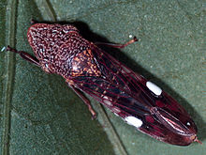
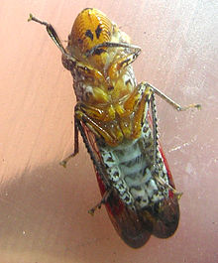
Glassy-Winged Sharpshooter Homalodisca vitripennis
Has glassy wings
Wings are brown with reddish tones
Dark brown top
Yellow eyes
Yellow and black underside
Top
Bottom

Slide 19
Glassy-Winged Sharpshooter Homalodisca vitripennis (cont.)
Feed on many species of plants such as citrus, grape and almond plants
Carries some bacterium
Plants that contain this species eggs have a whitish waxy residue on some leaves
Not found in Michigan
Controls have been successful including insecticides, viral pathogens and biological control (a type of wasps)

Slide 20
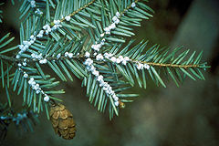
Hemlock Woolly Adelgid Adelges tsugae
The white stuff
Feeds off of the sap of hemlock trees
Simultaneously injects a toxin which severely
damages the tree
Is found in Michigan but not considered a pest
Controls are biological control and treatment of individual trees
However, both only work on small scales

Slide 21
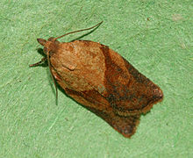
Light Brown Apple Moth Epiphyas postvittana
They look a lot like other moths so DNA tests are currently required to 100% identify
Causes damage to various fruits
Is not a pest in the U.S. at all
Insecticides and biologic controls have been used where it is a pest though

Slide 22
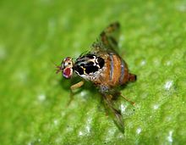
Mediterranean Fruit Fly Ceratitis capitata
These look creepy as hell
Lay eggs on the inside of various fruit
Spread through global fruit trade
Causes damage to fruit crops
Not in Michigan
A method of biologic control called the “sterile insect technique” has been successful in combating this species
The technique is to release a huge number of sterile Mediterranean Fruit Flies

Slide 23
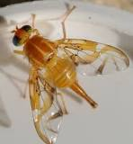
Mexican Fruit Fly Anastrepha ludens
Yellow, glassy look
Spread through migrant workers from Mexico
bringing infested fruit
Damages crops, mainly citrus fruits
Not found in Michigan
Controls include quarantine and the sterile insect technique

Slide 24
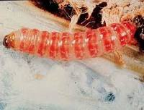
Pink Bollworm Pectinophora gossypiella
I mean it’s pink.
However, the adult forms are moths but I
don’t expect you to be able to identify this form
They cause damage to cotton crops by damaging the bolls from the insides
Not in Michigan
Controls include host-free periods, a cleansing of the crop cycle and insecticides which must be used in extreme moderation

Slide 25
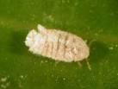
Pink Hibiscus Mealybug Maconellicoccus hirsutus
Again these are pretty distinct
Infests a lot of plants by injecting a toxic saliva which usually destroys parts of the plant
Not found in Michigan
Controls include pesticides (doesn’t work at all) and biological control (parasites) which works somewhat better

Slide 26
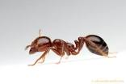
Red Imported Fire Ant Solenopsis invicta
They’re the ones that look like ants and are red
Cause damage through really painful bites and building mounds that disrupt crop roots
Not found in Michigan
Controls are typically pesticides

Slide 27
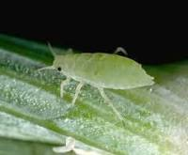
Russian Wheat Aphid Diuraphis noxia
Small pale green insect
Spindle-shaped body often covered in a powdery coating of wax
Has a notched tail unlike others of its species

Slide 28
Russian Wheat Aphid Diuraphis noxia (cont.)
Goes through cycles of being very harmful to being a negligible annoyance
Causes damage to grasses such as wheat and barley; it causes white up/down streaks on the leaves
Controls include good planning (early planning, avoiding water stress, etc.)

Slide 29
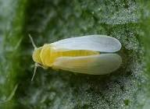
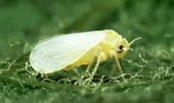
Silverleaf Whitefly Bemisia argentifolii
~1.5 mm long
Yellow body with white wings
Wings are roof-like and don’t touch
Attack cotton plants which destroys or severely reduces the quality of cotton bolls/plants
Not found in Michigan
Controls are either up to farmers to maintain crops or biologic controls (generally wasps)

Slide 30
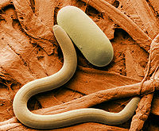
Soybean Cyst Nematode Heterodera glycines
This is the only invertebrate that is often invisible to the naked eye
They’re these worm-like things though
They destroy soybean plants
Is found in Michigan

