Slide 1
Inv. Species – Aquatic Plants, Fungi, Viruses
Lecture 4

Slide 2
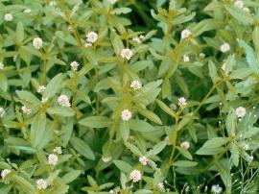
Alligatorweed Alternathera philoxeroides
White, ball-like flowers
Thin leaves that form star-shapes
Generally grows very thickly
Found in warmer climates
Reduces water flow and quality by blocking sunlight
Controls include releasing certain insects, most commonly, the alligator weed flea beetle

Slide 3
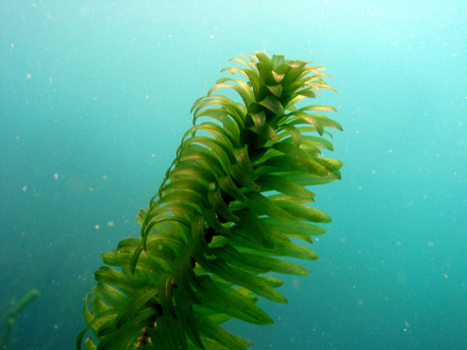
Brazilian Waterweed Egeria densa
Whorls of 4-6 leaves
Leaves have tiny fine teeth along the edges
Not found in Michigan
Limits water flow and activities such as swimming or fishing
Is a popular aquarium plant which is how it spreads so easily (people dumping their aquariums in ponds/lakes)
Controls don’t work

Slide 4
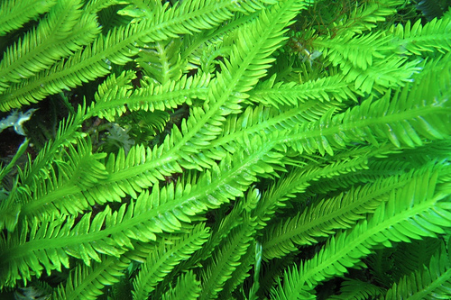
Caulerpa, Mediterranean Clone Caulerpa taxifolia
Notably has a “neat” arrangement of leaves
Aquarium plant, not in the Great Lakes
Is said to crowd out many species of fish
Helps control polluted waters
A certain type of slug helps control, but isn’t able to survive in the Mediterranean where this is more of a problem

Slide 5
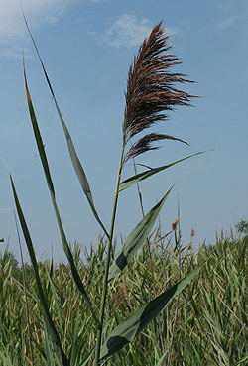
Common Reed Phragmites australis
Very blowy –Jinyoung Kim
Found in Michigan
Chokes out other plants such as wild rice/cattails
No notable controls

Slide 6
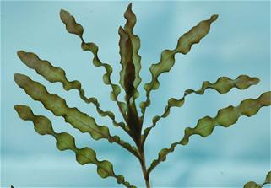
Curly Pondweed Potamogeton crispus
Easily identifiable by the oddly shaped leaves
Found in the Great Lakes region
Competes with native species
Clogs waterways (rivers, streams etc)
Control is mostly just cutting it down to reduce the population

Slide 7
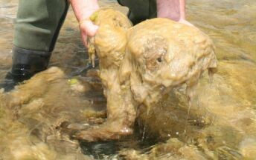
Rock Snot Didymosphenia geminata
Looks like a bunch of goop
An invasive species to the southern hemisphere
Is a microscopic type of algae
Doesn’t pose much threat
Just makes recreational fishing/boating annoying
Control is mostly just preventing further spread by civilians being careful

Slide 8
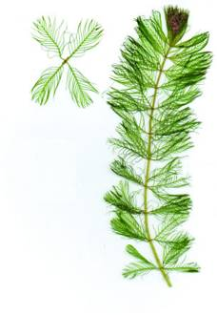
Eurasian Watermilfoil Myriophyllum spicatum
The leaves have 4 whorls
Small orange-red flowers
Found in the Great Lakes region
Crowds out native species
Disrupts recreational activities
Controls biologic control (moths or sterile Asian Carp) and manual removal

Slide 9
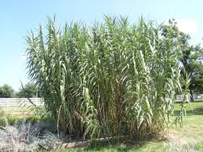
Giant Reed Arundo donax
Mostly only distinguishable from the common
reed because it’s giant-sized
Found in Michigan
Originally introduced to control erosion
Crowds out native species
Contributes to higher fire frequency/intensity
No notable controls

Slide 10
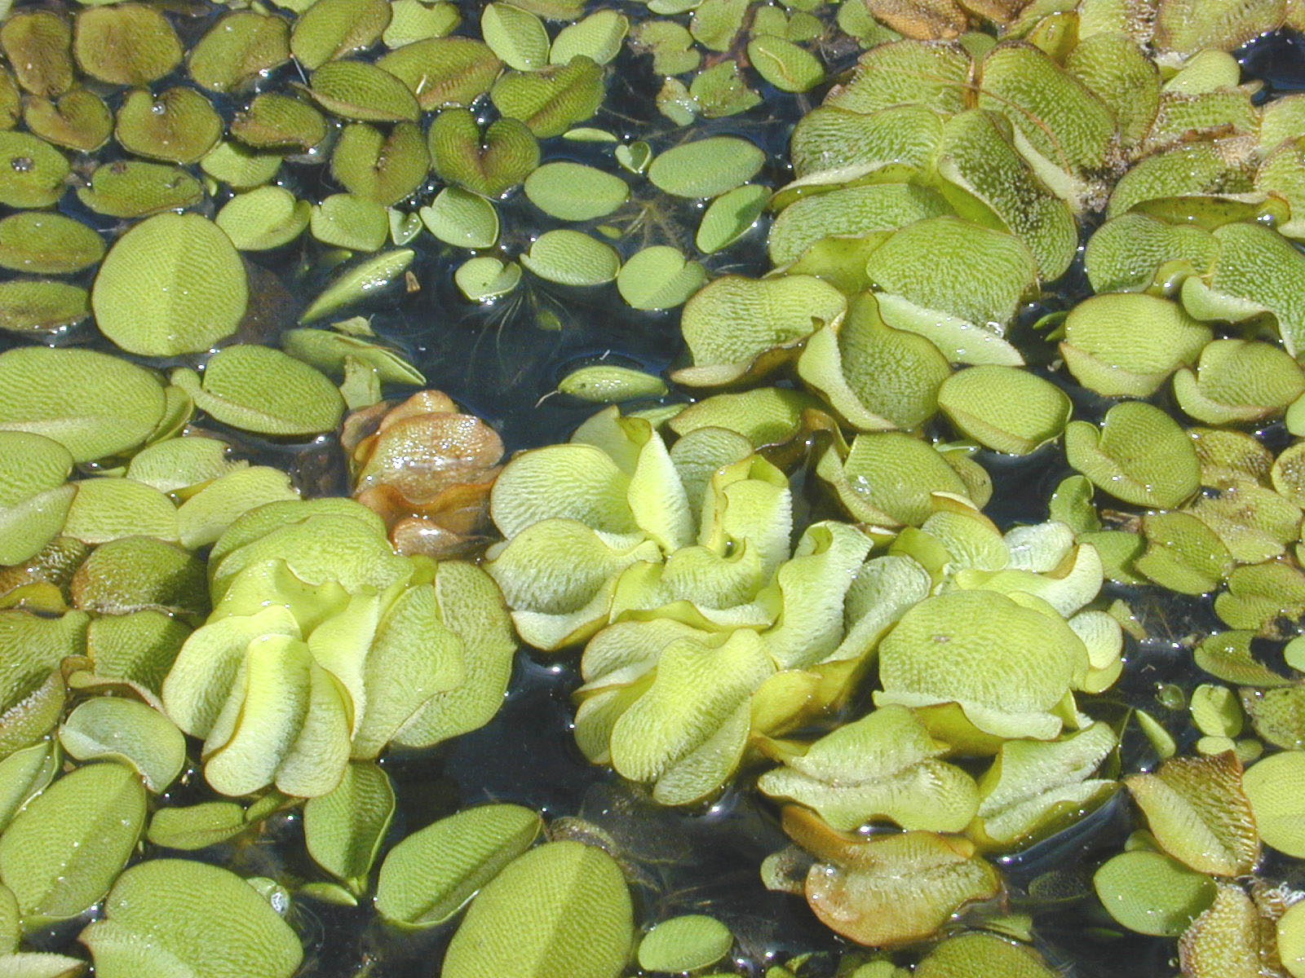
Giant Salvinia Salvinia molesta
Is only found floating in the water
Looks a bit like a bunch of beans
Not found in Michigan
Forms mats that block sunlight and reduces oxygen to the water
Biologic control (weevil) works best, manual and chemical have been used as well

Slide 11
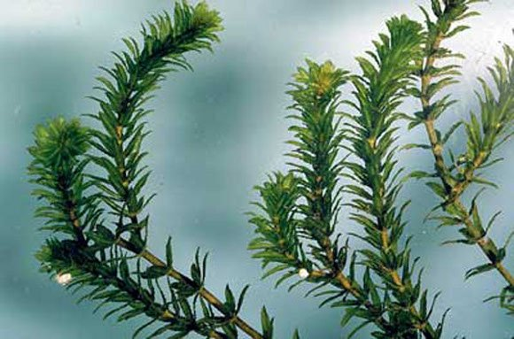
Hydrilla Hydrilla verticillata
Whorls with 2-8 leaves
Oftentimes has reddish streaks
Not found in Michigan
Introduced through aquariums
Crowds out native species
Messes with irrigation and boating
Controls include chemicals, grass carp and various insects

Slide 12
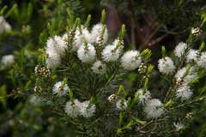
Melaleuca Melaleuca quinquenervia
Most notably has brush-like flowers (pink or white)
Not found in Michigan
Originally introduced for erosion control and beauty
Crowds out native species
Only control is the regulation of movement of the plant

Slide 13
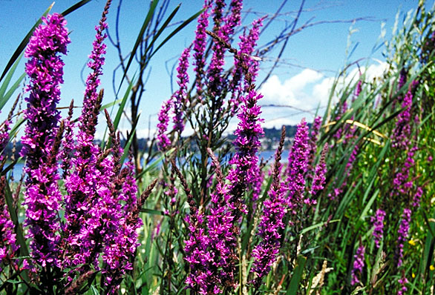
Purple Loosestrife Lythrum salicaria
Reddish stalks
Clusters of purple flowers near the top
Found in Michigan
Introduced through ship’s ballast and for aesthetic purposes
Crowds out native species
Reduces water flow
Controls are mostly biological (beetles)

Slide 14
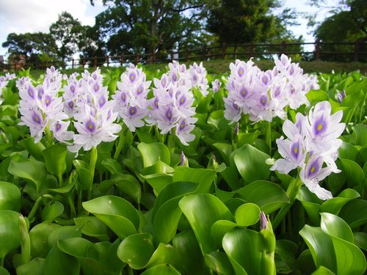
Water Hyacinth Eichhornia crassipes
Notably white-lilac flowers
Broad, waxy leaves
Found in Michigan
Introduced for aesthetic purposes
Has the potential to completely cover bodies of water, restricting water flow and oxygen
Controls are mostly biological (weevils)

Slide 15
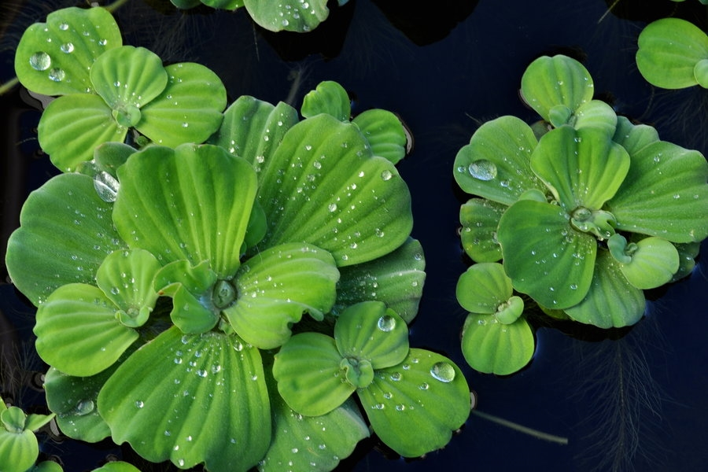
Water Lettuce Pistia stratiotes
Thick leaves in a rosette-shape, similar to lettuce
Found in Michigan
Restricts water flow and oxygen
Promotes the growth of mosquitos
Controls are primarily manual removal
Chemical and biological (weevils/moths) have also been used

Slide 16
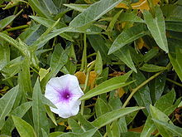
Water Spinach Ipomoea aquatica
This is the Chinese kind of spinach
Leaves are paper-airplane shaped
Not found in Michigan
Can form mats which block sunlight
Is delicious
No notable controls

Slide 17
Dutch Elm Disease Ophiostoma
Branches, starting from the top, will begin to die prematurely
Found in Michigan
Introduced through diseased logs w/ beetles
Manual removal, chemical treatment and fungal injections have all been used as controls

Slide 18
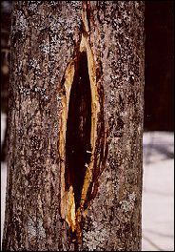
Butternut Canker Sirococcus clavigignenti-juglandacearum
Trees will have these huge gashes
Huge problem in Michigan
Spread through rain where spores will invade other trees
Controls primarily consist of breeding butternut trees to be resistant to this fungus

Slide 19
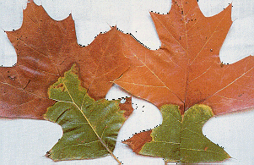
Oak Wilt Ceratocystis fagacearum
Most notably causes discoloration in the leaves
Found in Michigan
Infected trees will usually die within six months
Spreads either through insects or using root connections
Controls are primarily prevention rather than curing
We usually use careful planning habits

Slide 20
Whitenose Bat Syndrome Pseudogymnoascus destructans
This is the one that kills bats
I will talk more about this in the binder, don’t think it’s necessary to know for now

Slide 21
Viruses
Blue Tongue Virus Orbivirus
West Nile Virus Flavivirus
Bird Flu H5N5
I will go over these in more detail in the binder

