Slide 1
Inv. Species – Plants I i
Lecture 5

Slide 2
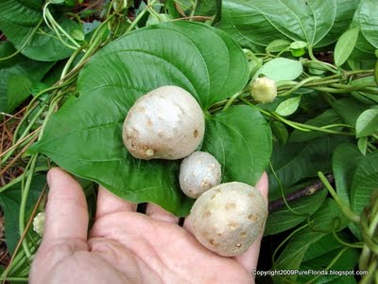
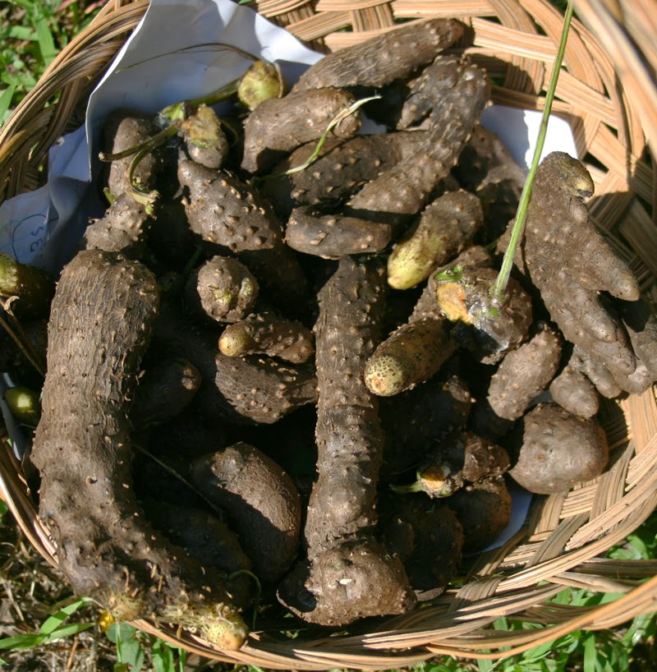
Air Potato Dioscorea bulbifera
Broad leaves
Brownish bulbis
Tubers, shaped like small elongated potatoes
Mostly found in the south/southeast
Dense vines smother native species
Introduced as a food crop
Controls are biological (beetle

Slide 3
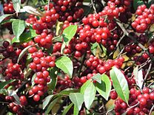
Autumn Olive Elaeagnus umbellata
Has red fruit that kind of look like grapes
Leaves have tiny silvery “scales”
Found in Michigan
Introduced for aesthetic reasons
Displaces native species
Controls only include preventing further spread

Slide 4
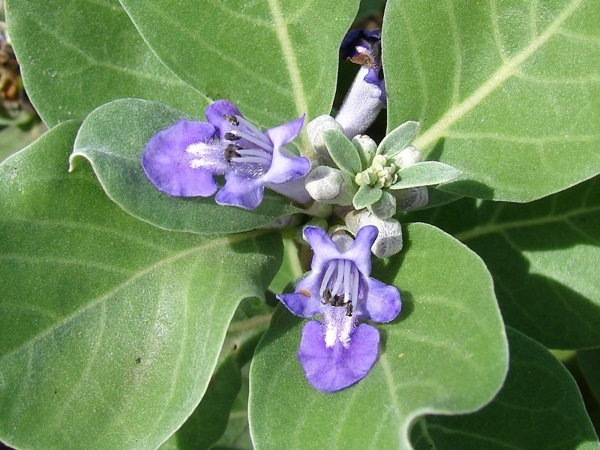
Beach Vitex Vitex rotundifolia
Has distinctive two-lipped blue-purple flowers
Found mostly in the southeast
Introduced as means of erosion control
Crowds out native species
Destroys sea turtle habitats
We go around with a machete and chop them down, 6 months later, we go back and remove the stems

Slide 5
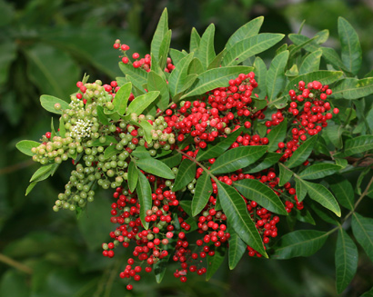
Brazilian Peppertree Schinus terebinthifolius
Bright red berries that grow in clumps
Introduced for aesthetic reasons
Only found in Florida
Crowds out native species
Might produce a chemical which inhibits the growth of other plants
Herbicides

Slide 6
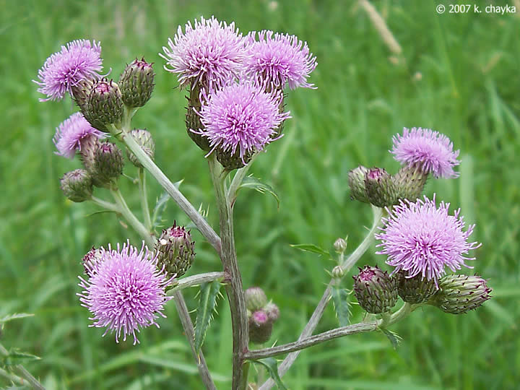
Canada Thistle Cirsium arvense
Flowers are pink-purple spiky balls
Found in Michigan
Introduced through farm shipments
Crowds out native species
Reduces crop yields
Controls are exclusively biological (fungi and flies)

Slide 7
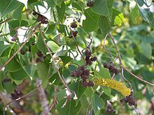
Chinese Tallow Triadica sebifera
Flowers are greenish-yellow stalks
Berries are brown-black
Not found in Michigan (Wisconsin though)
Introduced for aesthetic reasons and for seed oil
Is one of the main plants used for biodiesel
Crowds out native species
Controls include herbicides and fire

Slide 8
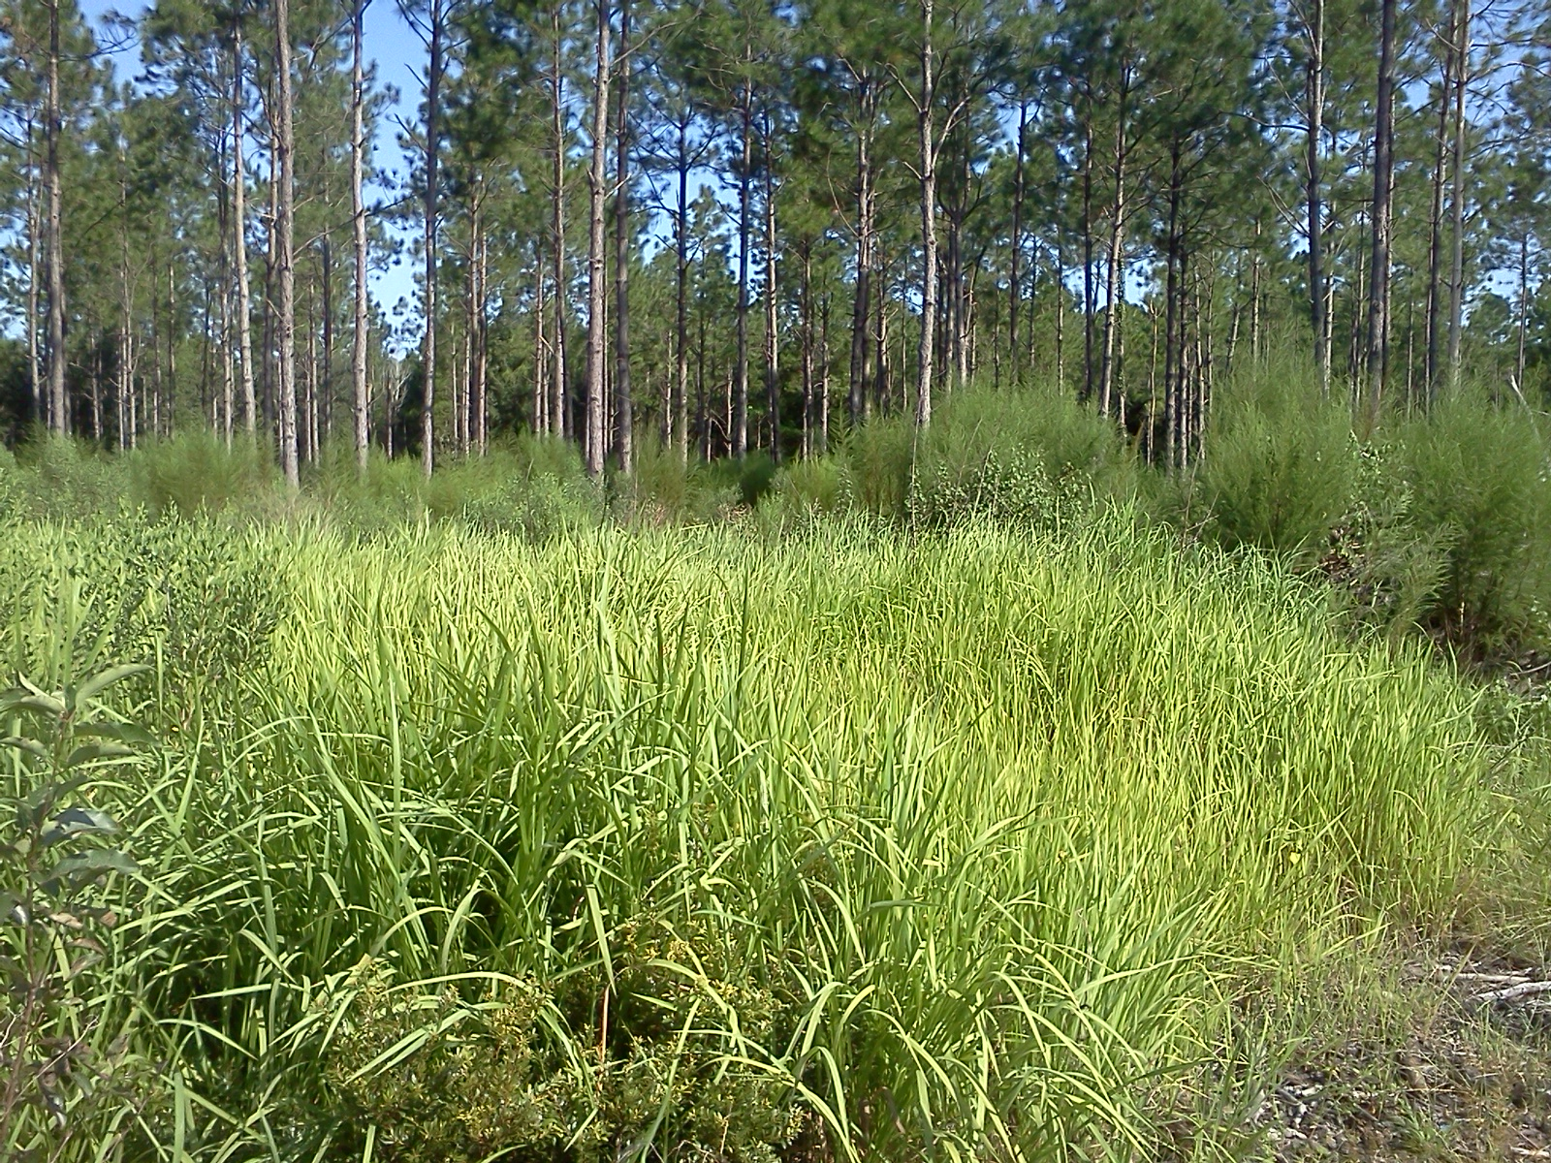
Cogongrass Imperata cylindrica
2 cm at its base, narrows to a sharp point
Main vein is a lighter color
Upper surface is hairy near base, lower is not
Mostly found in the south
Crowds out native species
Has a tendency to catch on fire (not as much of a problem in the US)
Controls are usually herbicides

Slide 9
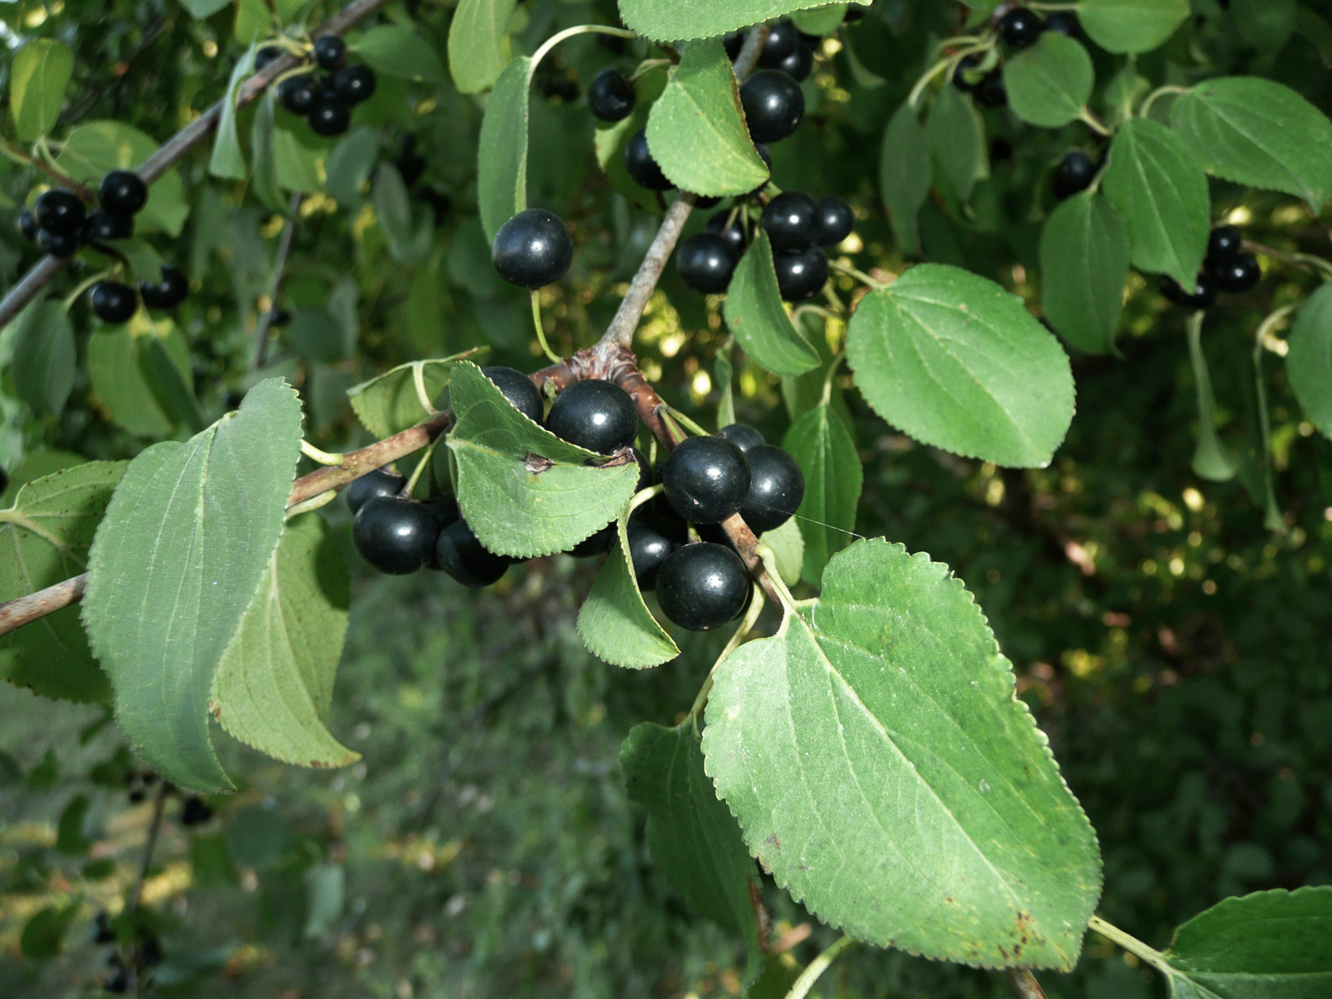
Common Buckthorn Rhamnus cathartica
Most easily identified by black rounded berries
They’re poisonous though so don’t at them
Found in Michigan
Crowds out native species
Control is generally cutting them down and applying herbicides to the stumps although this is a short term solution

