Slide 1
Inv. Species – Plants I ii
Lecture 5

Slide 2
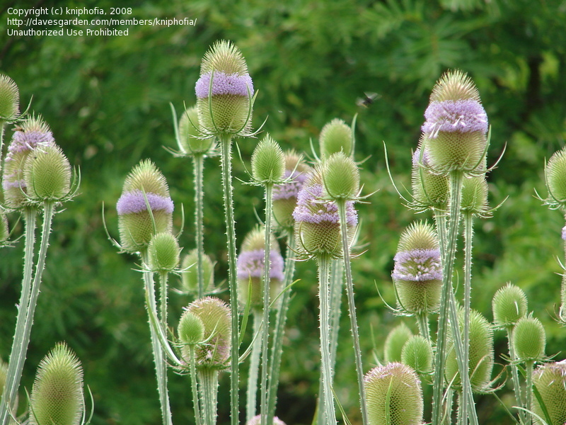
Common Teasel Dipsacus fullonum
Has purple-pink prickly thingies on top
Found in Michigan
Crowds out native species
Fairly easy to control
We either dig them up or apply herbicides

Slide 3
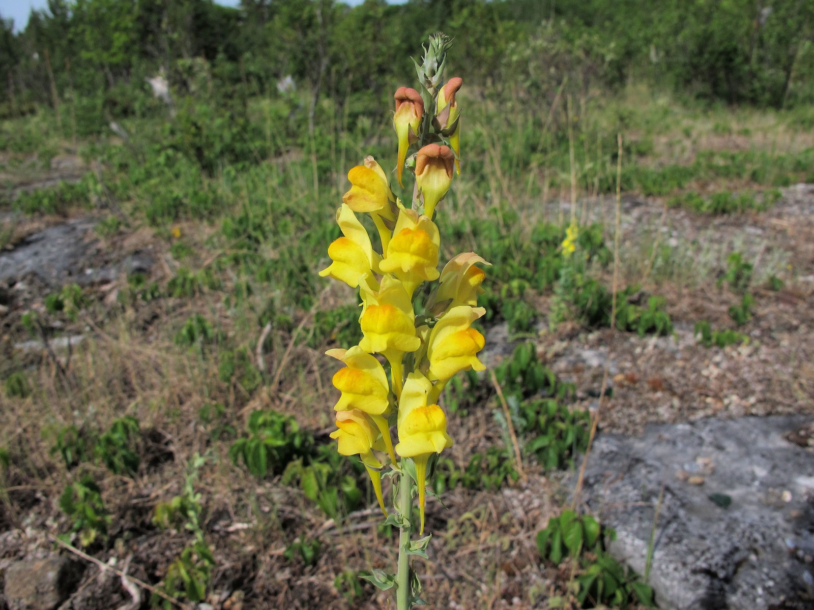
Dalmatian Toadflax Linaria dalmatica
Notable for its bright yellow flowers
Found in Michigan
Introduced for aesthetic reasons and to use for dye
Crowds out native species
Controls are biological such as moths

Slide 4
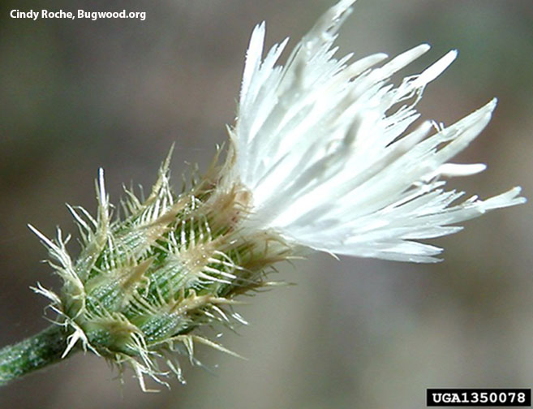
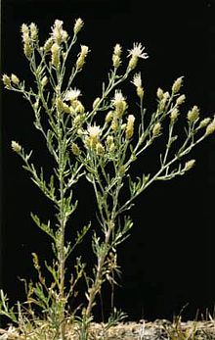
Diffuse Knapweed Centaurea diffusa
Creepy/spiky looking
White or pink, urn-shaped flowers
Found in Michigan
Introduced through contaminated seed shipments
Crowds out native species
Controls include all of biological, manual and chemical

Slide 5
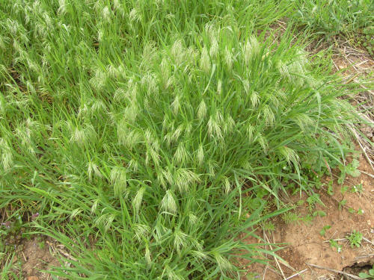
Downy Brome Bromus tectorum
Found in every state
Introduced through contaminated shipments
Downy Brome has been found to be very
responsive to atmospheric CO2 levels
Controls are generally a combination of:
Chemical controls
Careful farming practices

Slide 6
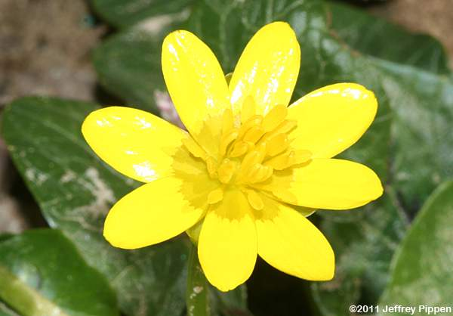
Fig Buttercup Ficaria verna
Simple bright yellow flowers
Found in Michigan
Introduced for aesthetic purposes
Crowds out native species
Controls are limited to manual for small scale and chemical for larger scale

Slide 7
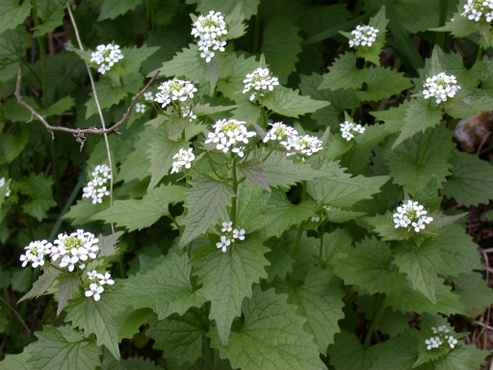
Garlic Mustard Alliaria petiolata
Flowers form in white button-like clusters
Found in Michigan
Introduced for food and medicinal use
Crowds out native species
Controls are manual and chemical

Slide 8
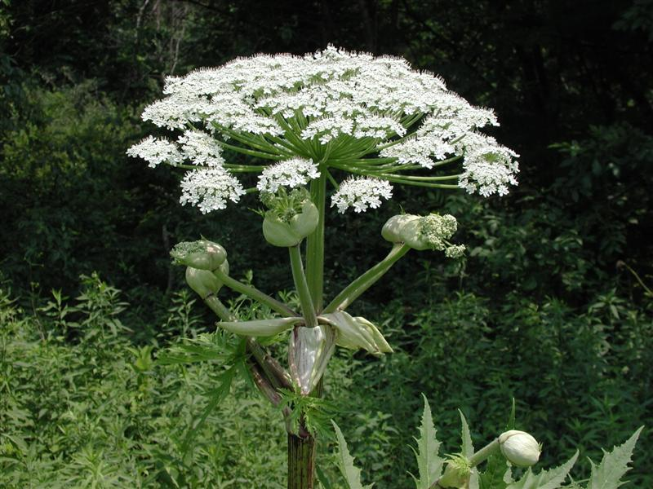
Giant Hogweed Heracleum mantegazzianum
Holds several clusters of white flowers
above a single green stalk
Found in Michigan
Introduced for aesthetic reasons
Crowds out native species
Produced a toxic sap which can cause blindness
Controls are only cultural and manual

